Slide 1
MULTI MODE INTELLIGENT AND ADAPTIVE SMART VEHICLES (MMIV)
Mr. PREMKUMAR R M.E(Ph.D.)
MOHAN PRASATH S
Assistant professor - Department of Electrical and Electronics Engineering, SECE
Pre Final year UG Student - Department of Electrical and Electronics Engineering, SECE

Slide 2



INTRODUCTION
1
Speed Control
3
Accident Monitoring
Vehicle's speed restriction by using RFID tag.
If any accident occurs , it will be intimated to parents/ guardians.
2
Auto-Braking System
Any obstacle detect in front of the vehicle, the vehicle will slow down automatically.

Slide 3


PROBLEM STATEMENT
01
Over Speeding.
02
Improper timing of applying brake.
03
Negligence of accident report .

Slide 4
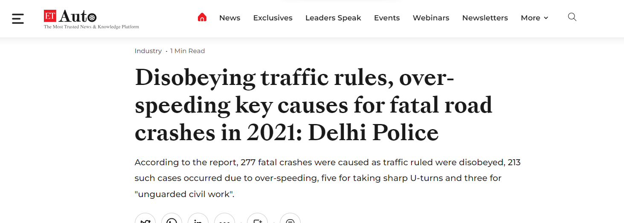
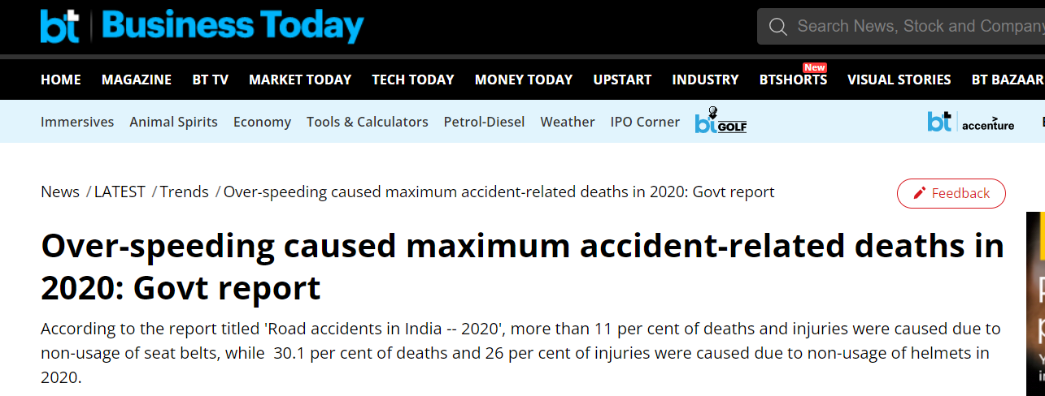
STATISTICS
Over Speeding
Careless Driving
Alcohol ,
Climatic Condition
Defects in Mechanism
6.7%
9.9%
10,365
15,357
55.9%
27.5%
42,853
87,050
SOURCE : Economic times , Business today news
MAJOR CAUSE OF ROAD ACCIDENT DEATHS DURING 2021

Slide 5
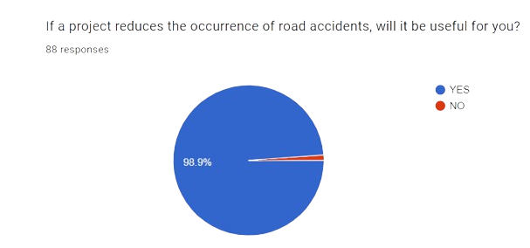
MARKET SIZE
Lack of speed control , Auto-braking system in vehicles.
There will be a big impact in market.
Reliability and safety of riders.
In our survey, 98.9% people are interested with this added features in vehicles.

Slide 6
GAP ANALYZED WITH EXISTING SOLUTIONS
Till now, No one companies that implemented speed-controllable features in vehicle using RFID technology.
For most accurate information, RFID technology is more efficient.
And also we implement automatic braking system.
This results in the Uniqueness of this added features.

Slide 7
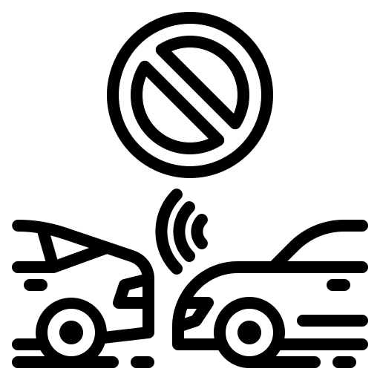





METHODOLOGY
1
2
3
4
5

Slide 8
PROPOSED SOLUTION
Speed of vehicles are controlled by RFID tag.
By scan RFID , we maintain certain speed limit.
If obstacle is detected, the vehicle gets slow down.
If any accident occurs , it will be intimated to parents phone.
THE SOLUTION
The application Provides the accessibility to lock and unlock the vehicle.

Slide 9
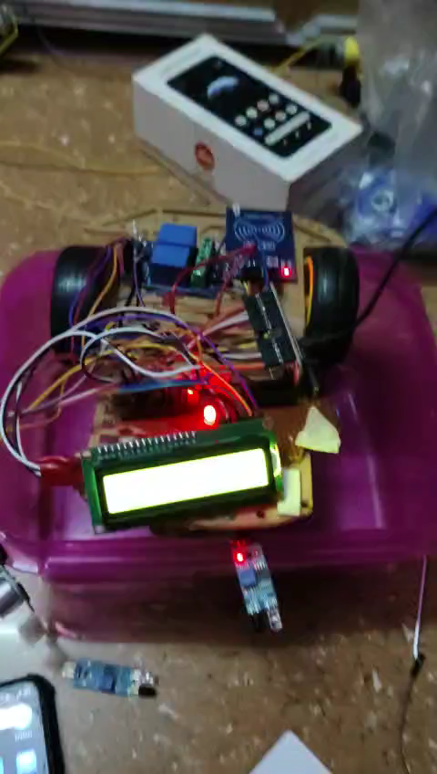
DEMO VIDEO

Slide 10
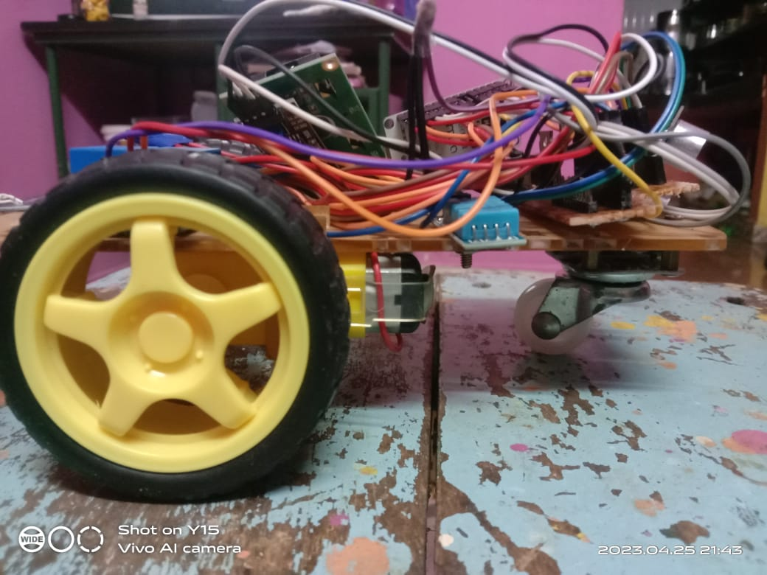
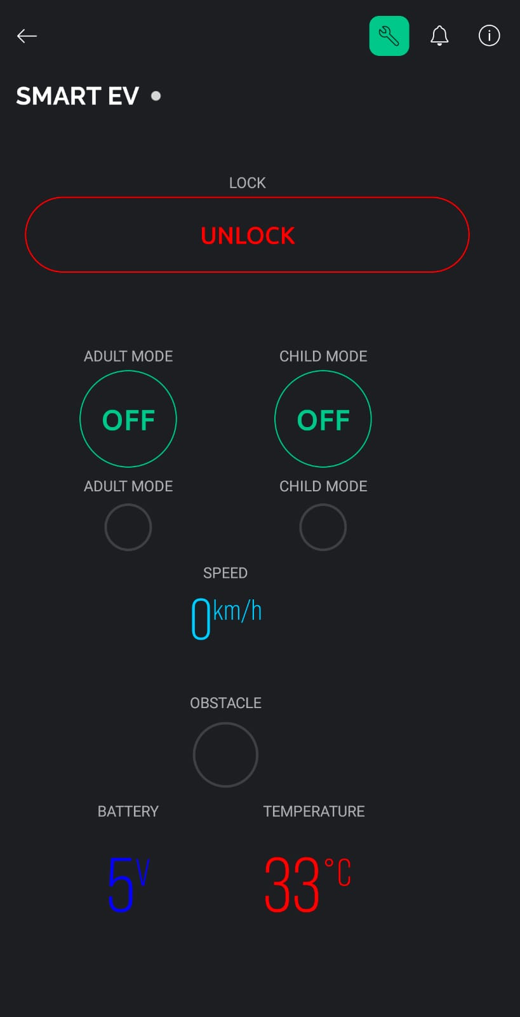
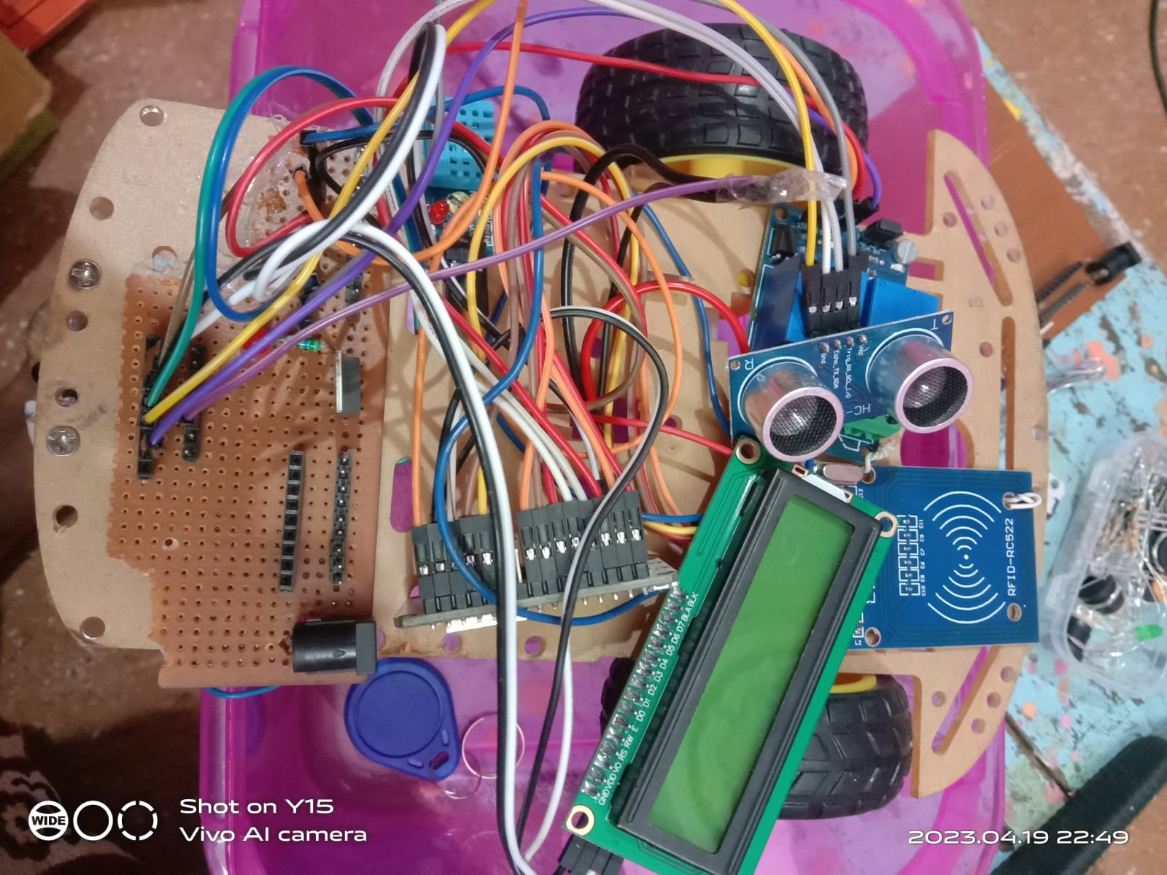
PROTOTYPE & ITS CURRENT LEVEL

Slide 11
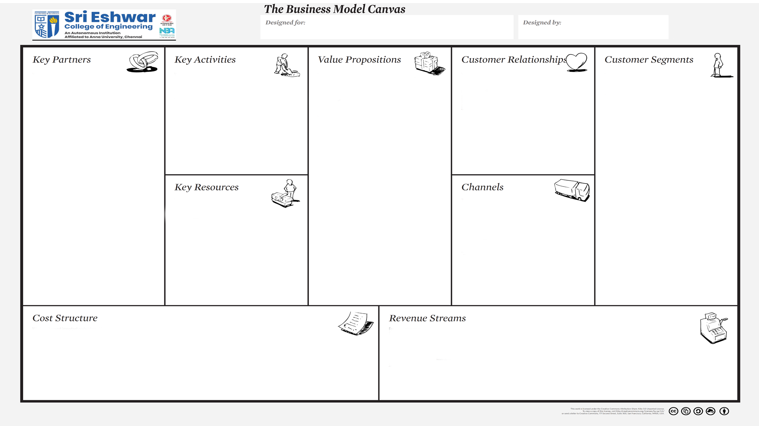

Vehicles user
Students
Literature survey on the need for the product proposed.
Design and prototype the product.
Build marketing strategies Establish a network of people with key partners.
Maintain the accounts.
Phone call or live chat assistantship for the customers in need of any help.
Partnerships with Car service units to provide customers services.
Brake manufactures (Example :Volvo, GWR safety systems).
Automobile brake manufactures (Example: Faurecia, Johnson controls, Brose).
RFID manufactures (Example: Maxim integrated).
Micro controller board manufactures (Example : Arduino and Raspberry Pi manufactures).
Automobile companies (Example: Continental, Bosch, Tesla).
Health assistance during driving/travelling - Safety is the highest priority.
Reduces the chances for accidents caused due to over speeding.
(Example : Drinking and Driving).
All age group people can use.
And there is no restrictions.
Specially for teenagers , Rash drivers.
Work space-Electronics circuit laboratory.
Components required Access to Internet – for literature survey.
Financial support to carry the project further.
Teachers guidance in case of doubts.
Producer
Automobile manufacturer
Supplier
Customers
Cost involved in establishing the partnership with the mentioned key partner. Production /Manufacturing cost : Developing the product and mobile application.
(Variable cost as per the units in need)Marketing cost.
Transaction Revenue : During the time of purchase of the product
Recurring Revenue : Extra charges for subscription using app & Each the customers sign up for customer service.

